Slide 1
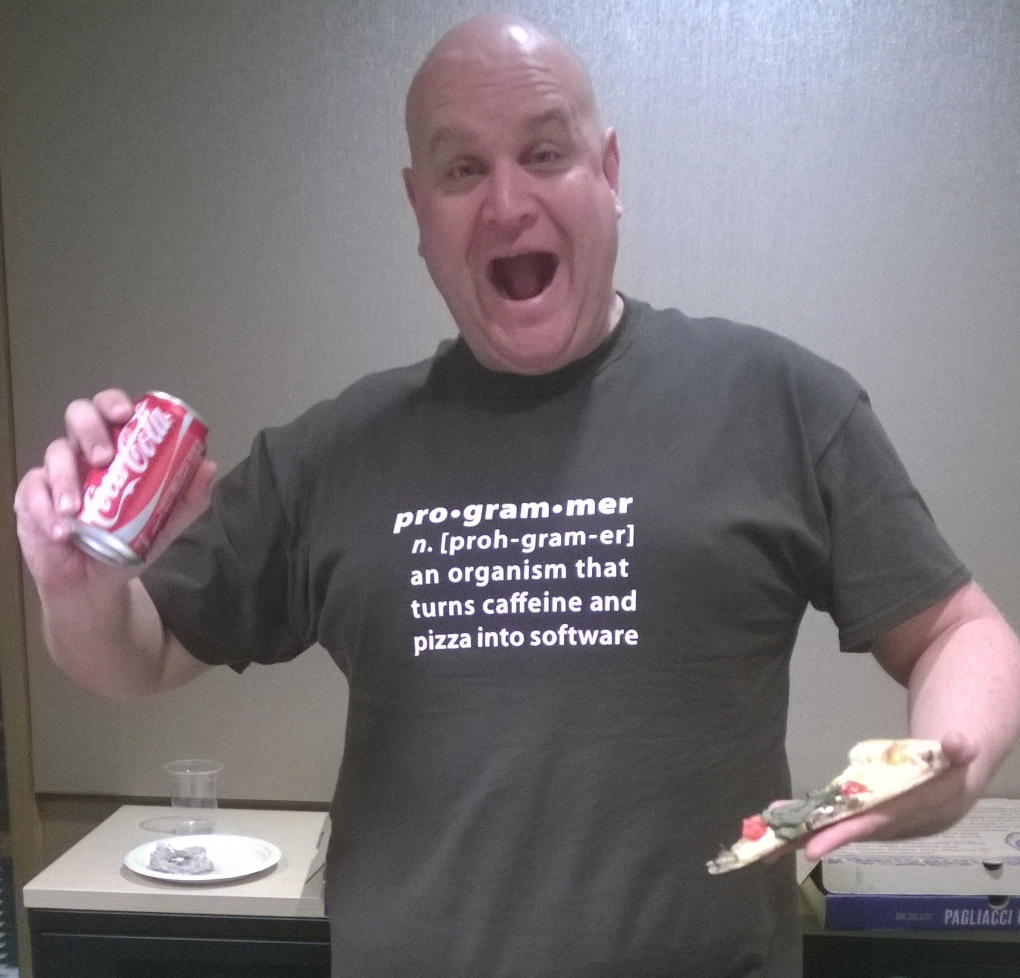

Indexing Nirvana with Azure DocumentDB
Ryan CrawCour Program Manager, Microsoft @ryancrawcour | David Makogon Cloud Architect, Microsoft @dmakogon

Slide 2
Today’s talk
What is DocumentDB? (5-minute lightning-round edition)
Meet today’s data: Movies
Queries and indexing: Demos with a side of Q&A
Loud applause & amazing #DocumentDB @ #NoSQLNow tweets!

Slide 3
Azure DocumentDB: Lightning Round Edition
{
name:"Azure DocumentDB",
deployedAs: "Service",
dbType: "Document",
connectVia: [ "rest", "sdk" ],
deployVia: [ "portal", "rest", "cli", "sdk" ],
scaleVia: [ "portal", "rest", "cli", "sdk" ],
differsVia: [ "js", "indexing", "consistency" ]
}
Notes:
Jump to portal to show features

Slide 4




DocumentDB Resource Model
Account
Databases
Collections
Documents
Attachments
1010100100
Users
Stored Procedures
JS
{
"id" : "123" "name" : "joe"
"age" : 30
"address" : {
"street" : "some st"
}
}
Permissions
Triggers
JS
User Defined Functions
JS
Notes:
SQL syntax – familiarity with traditional
- automatically indexed
- flexible schemas
Multi-document transactions
- stored procedures/triggers is transactional
Tunable and fast – consistency levels
- strong
- bounded staleness
- session
- eventual
- indexing
-consistent
-lazy
Highly scalable – customers with terabytes
- fully managed
- quick startup

Slide 5
Service consumption
{
units:"RequestUnit",
timePeriod: "per second",
tiers: [250, 1000, 2500],
billedBy: "hour",
behavior: [ "consistent", "predictable" ],
measured: "per operation",
reportedVia: "result header"
}
Notes:
Jump to portal to show features

Slide 6
Indexing
{
"id" : "123",
"age" : 30, "name" : "joe",
"address" : {
"street" : "some st",
"city" : "San Jose"
}
}
/id /age
/name /address /address/street
/address/city
Range index
Hash index

Slide 7
Data

Slide 8
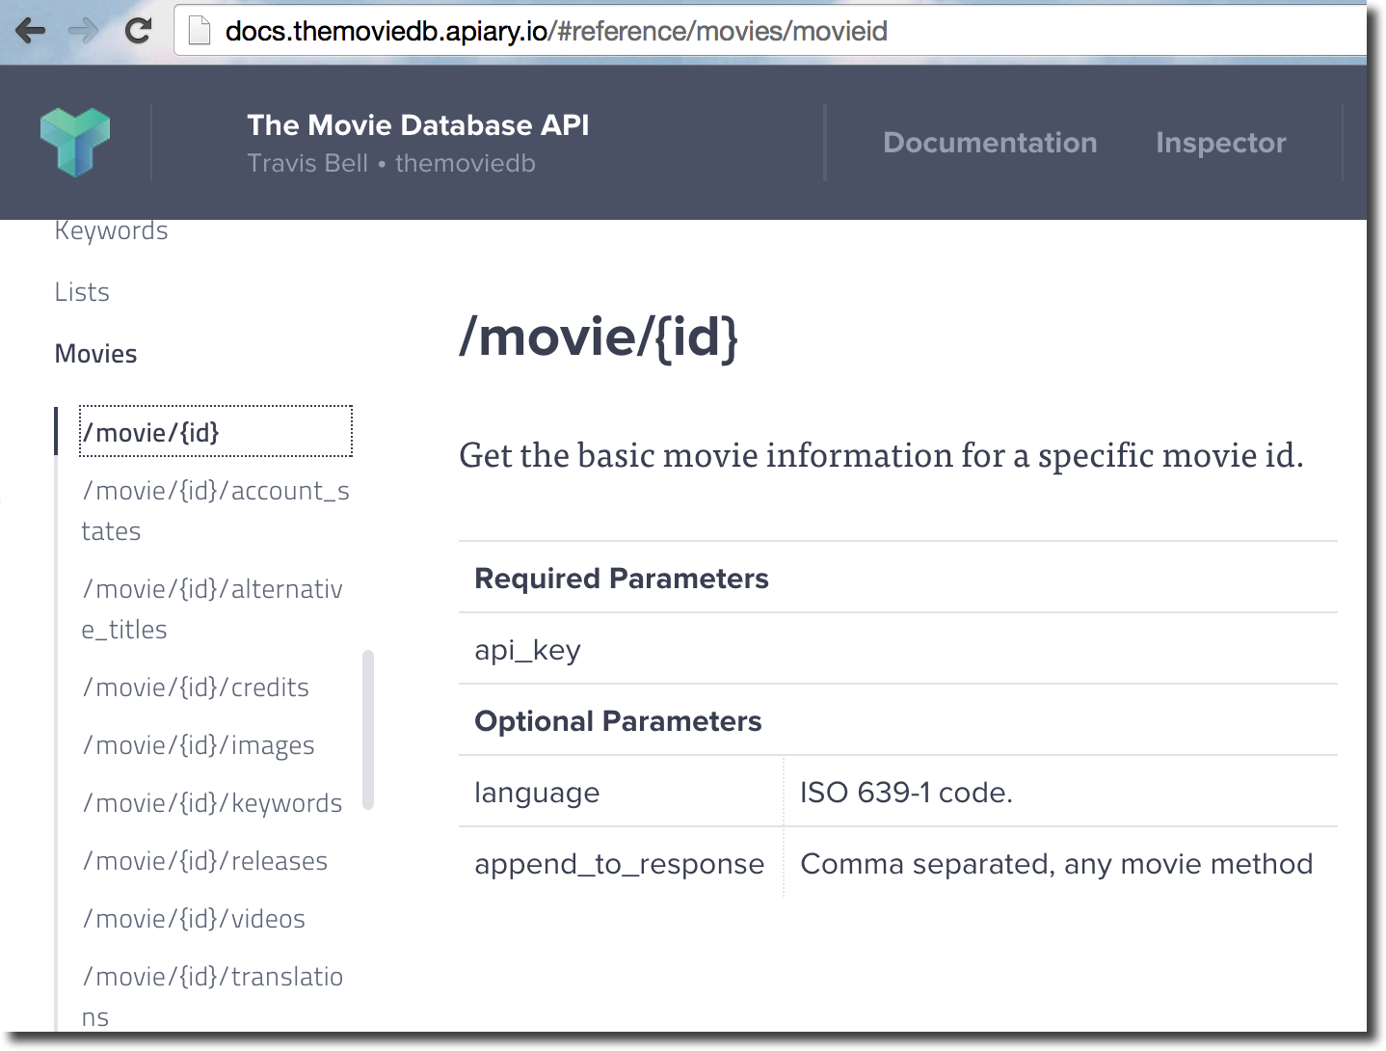
Meet today's demo data: Lots of movies

Slide 9
Example movie JSON
{
"genres": [
{ "id": 35, "name": "Comedy" },
{ "id": 28, "name": "Action" },
{ "id": 12, "name": "Adventure" } ],
"id": "movie203801",
"overview": "In the early 1960s, ...",
"release_date": "2015-08-14",
"runtime": 116,
"tagline": "A Higher Class of Hero.",
"title": "The Man from U.N.C.L.E.",
"vote_average": 3.5,
"type": "movie"
}

Slide 10
Demos

Slide 11
Default indexing
SELECT * FROM movies m
WHERE m.title = "Ant-Man"
SELECT * FROM movies m WHERE m.vote_average >= 3 AND m.vote_average <= 4
Equality on strings
Range on numbers
Notes:
<querymovie.js>

Slide 12
Arrays
SELECT m.title, m.overview
FROM movies m
JOIN g IN m.genres
WHERE g.name="Comedy"
Notes:
Portal only

Slide 13
Ranges on strings?
SELECT *
FROM Movies m
WHERE m.title BETWEEN "A" AND "B"
Notes:
Run addrangeindexes.js. After, run resetindexes.js

Slide 14
Exclude paths from index
SELECT *
FROM Movies m
WHERE m.overview = 'Documentary'
Notes:
Excludepath '/overview/*' then run resetindex

Slide 15
Geospatial
SELECT * FROM cinemas c WHERE ST_DISTANCE(c.location, {
"type": "Point",
"coordinates": [-121.889125, 37.33034]
}) < 5 * 1600
SELECT * FROM cinemas c WHERE ST_WITHIN(c.location, {
"type": "Polygon",
"coordinates": [[ [-124.63, 48.36], [-123.87, 46.14], [-122.23, 45.54], [-119.17, 45.95], [-116.92, 45.96], [-116.99, 49.00],
[-123.05, 49.02], [-123.15, 48.31],
[-124.63, 48.36]
]]})
Notes:
TBD. Portal-only

Slide 16
Summary
{
default: [
"every path",
"hash on number",
"range on string"
],
indexKind : ["Hash", "Range", "Geospatial"],
indexTransforms: ["on demand", "online"],
paths: ["Include", "Exclude"],
mode: [ "Consistent", "Lazy"],
automatic: [ true, false ]
}

Slide 17




SDKs and Tooling
SDKs
Azure Portal
Studio
aka.ms/docdbsdks
portal.azure.com
aka.ms/docdbstudio
Notes:
DocumentDB offers SDKs and tooling to help you develop against and manage data in the service.
All APIs are accessible as REST over HTTP, we also provide .Net, Node, Java and Python SDKs
I already shown provisioning through the portal – the Azure Preview portal offers a variety of development, monitoring and management capabilities.
DocumentDB Studio is an open source app that allows you to manage and interact with the service from a GUI tool
The Data Migration tool allows you import existing data into DocumentDB

Slide 18






Get Started Today
select * from playground p where p.name = "DocumentDB"
explore playground
build an app
move some data
aka.ms/docdbplayground
aka.ms/docdbstarter
aka.ms/docdbimport

Slide 19
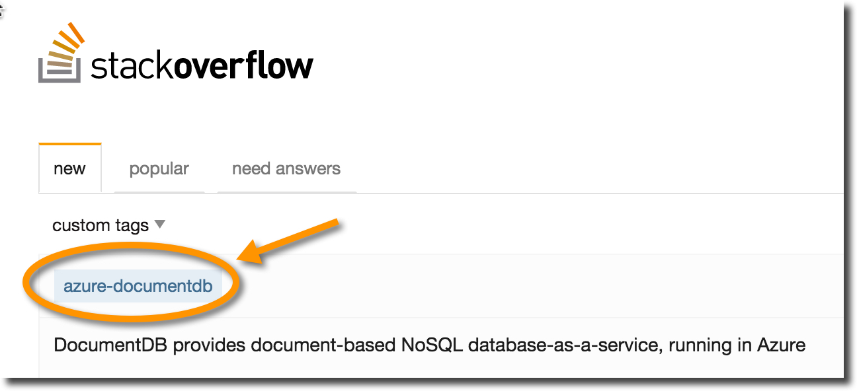
Wrapping up
documentdb.com
@DocumentDB
@dmakogon
@ryancrawcour
github.com/azure/azure-documentdb-node
github.com/dmakogon/nosqlnow2015

